Slide 1
Is there a relationship between the cost of a set of Legos and the number of pieces in a set of Legos?
Sample Presentation

Slide 2
Population
The population includes all Lego sets that are available for purchase from the website Lego.com or the Lego Store during December of 2015. Individual pieces, video games (Lego Dimensions), ornaments, clocks, magnets and mini-figures are not included in the study. Furthermore I only recorded the suggested retail price, avoiding discounts, sale prices, and clearance prices.
The sample consisted of 49 sets of Legos.

Slide 3
Description of Data
Independent Variable – Number of Lego pieces in a set (Numerical – Discrete).
Dependent Variable – Cost of the Lego set in US dollars (Numerical – Discrete)
One of the values used to assess a set of Legos set is the cost per piece which would be classified as Numerical – Continuous.

Slide 4
Sampling Technique
I gathered my data using a Stratified Random Sample.
Reason
Entering the shop.lego.com website, I selected shop by theme.
I started with the first theme and counted the number of sets.
Using a random number generator I selected 2 sets in that theme.
If a theme had more than 20 sets I selected 3 random sets.
After selecting a particular set I clicked on the link and recorded the MSRP and the number of pieces listed for the set.
There were 23 themes of which 3 themes had more than 20 sets (Creator, Marvel Superheroes, and Star Wars.)

Slide 5
Data Table
Theme | Set | Pieces | Cost |  | Theme | Set | Pieces | Cost
Architecture |  |  |  |  | Elves
 | Leaning Tower of Pisa | 345 | $34.99 |  |  | Skyra's Mysterious Sky Castle | 808 | $79.99
 | Architecture: Studio | 1211 | $159.99 |  |  | Aira's Creative Workshop | 98 | $9.99
Bionicle |  |  |  |  | Friends
 | Ketar Creature of Stone | 80 | $9.99 |  |  | Party Gift Shop | 52 | $4.99
 | Kopaka and Melum | 171 | $24.99 |  |  | Heartlake Cupcake Café | 439 | $39.99
City |  |  |  |  | Ideas
 | Deep Sea Scuba Scooter | 42 | $6.99 |  |  | Wall-E | 676 | $59.99
 | Rally Car | 104 | $9.99 |  |  | Ghostbusters Ecto-1 | 508 | $49.99
Creator |  |  |  |  | Juniors
 | Super Soarer | 100 | $9.99 |  |  | Family House | 226 | $29.99
 | Detective's Office | 2262 | $159.99 |  |  | Beach Trip | 74 | $9.99
 | Mountain Hut | 550 | $39.99 |  | Chima
DC Super Heroes |  |  |  |  |  | Mammoth's Frozen Stronghold | 621 | $59.99
 | Batman: The Riddler Chase | 304 | $29.99 |  |  | Maula's Ice Mammoth Stomper | 604 | $89.99
 | The Batboat Harbor Pursuit | 264 | $29.99 |  | Marvel Super Heroes
Disney Princess |  |  |  |  |  | Knowhere Escape Mission | 433 | $39.99
 | Cinderella's Romantic Castle | 646 | $69.99 |  |  | The Hydra Fortress Smash | 405 | $49.99
 | Daisy's Beauty Salon | 98 | $9.99 |  |  | The Shield Helicarrier | 2996 | $349.99

Slide 6
Data Table (cont.)
Theme | Set | Pieces | Cost |  | Theme | Set | Pieces | Cost
Minecraft |  |  |  |  | Technic
 | The Mine | 922 | $109.99 |  |  | Service Truck | 1276 | $129.99
 | The Snow Hideout | 327 | $34.99 |  |  | Snowmobile | 186 | $19.99
Mixels |  |  |  |  | The Simpsons
 | Tungster | 60 | $4.99 |  |  | The Simpsons House | 2523 | $199.99
 | Kramm | 68 | $4.99 |  |  | The Kwik-E-Mart | 2179 | $199.99
Pirates |  |  |  |  | The Lego Movie
 | Soldiers Outpost | 164 | $19.99 |  |  | Batman and Super Angry Kitty Attack | 115 | $9.99
 | Soldiers Fort | 234 | $29.99 |  |  | MetalBeard's Sea Cow | 2741 | $249.99
Scooby-Doo |  |  |  |  | Ultra Agents
 | Mummy Museum Mystery | 110 | $14.99 |  |  | Agent Stealth Patrol | 475 | $49.99
 | Haunted Lighthouse | 437 | $49.99 |  |  | UltraCopter vs. AntiMatter | 614 | $79.99
Speed Champions |  |  |  |  | Ninjago
 | McLaren Mercedes Pit Stop | 332 | $29.99 |  |  | Chain Cycle Ambush | 298 | $29.99
 | Porsche 918 Spyder | 151 | $14.99 |  |  | Final Flight of Destiny's Bounty | 1253 | $119.99
Star Wars
 | T-16 Skyhopper | 247 | $24.99
 | AT-AT | 1137 | $109.99 |  | Gathered Dec. 18th, 2015
 | Naboo Starfighter | 442 | $49.99

Slide 7
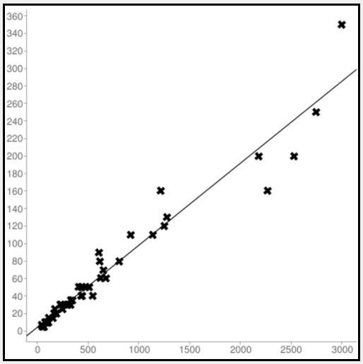
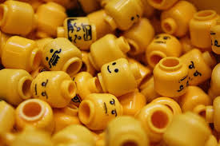
Scatter Plot
Line of Fit

Slide 8
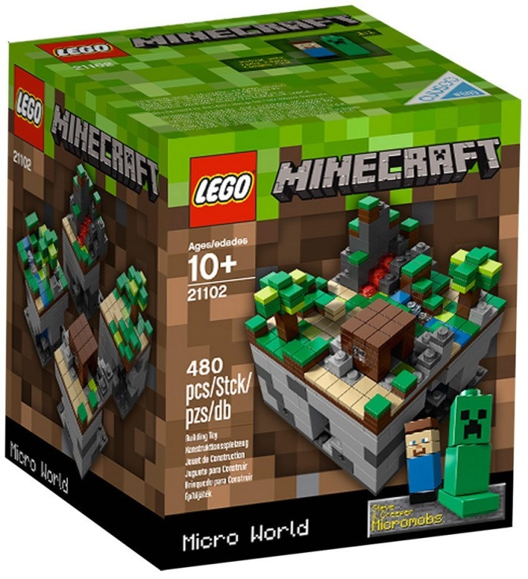
Pearson’s Correlation Coefficient
Looking at the graph and the data there seems to be a strong, positive correlation to the data.
Calculating out the correlation coefficient (r = 0.972) confirms that there is a strong correlation between the two variables.

Slide 9
Line of Fit and Coefficient of Determination
The Line of Fit
The slope (0.094) represents the average cost per Lego.
The y-intercept represents the base cost of each set.
Coefficient of Determination
This means that 94.5% of the data can be directed attributed to the line of fit. Again, a very strong correlation!

Slide 10
Descriptive Statistics
 | Independent (Number of Pieces) | Dependent (Cost of Set)
Mean | 620.6 | $62.50
Population Standard Deviation | 728.2 | 70.3
95% Confidence Interval | 416.7 < µ < 824.5 | $42.82 < µ < $82.18
A 95% confidence interval means that 95% of the samples collected would contain the population mean.

Slide 11
Weaknesses of the Study
Sets and prices can vary drastically. Stores such a Toys-R-Us will often inflate their prices which is why I used the actual Lego store as a source of prices.
Sets that are licensed such as Star Wars are often more expensive than their non-licensed counterparts.

Slide 12
Conclusion
In conclusion, I can state that there is a strong linear relationship between the number of Legos in a set and the price.
On average a set of Legos will contain around 620 pieces and will cost on average $62.50.

Slide 13
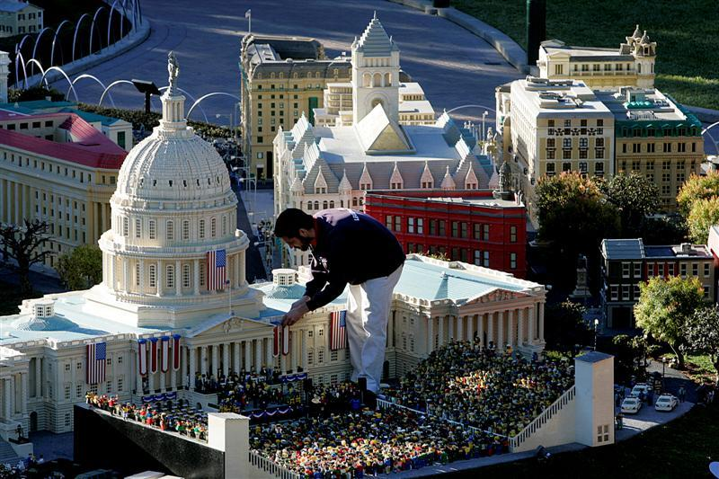

Slide 14
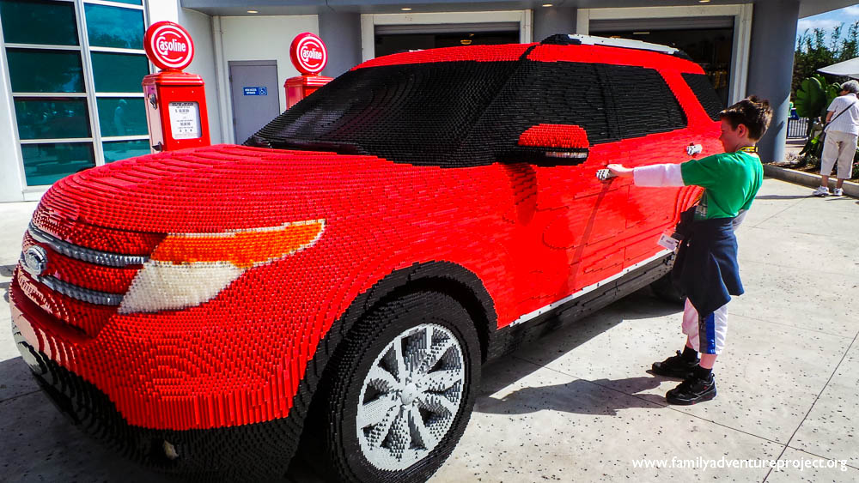

Slide 15
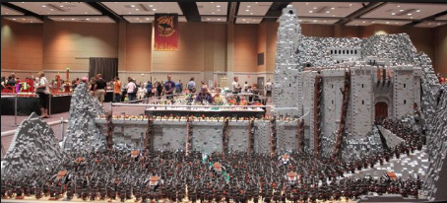
The Battle of Helms Deep

Slide 16
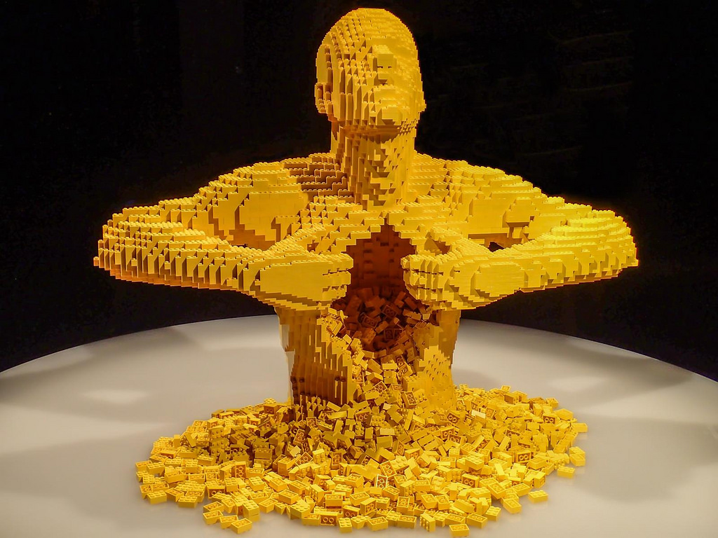
"Art of the Brick" exhibit at the Oregon Museum of Science and Industry in Portland, Oregon

Slide 17
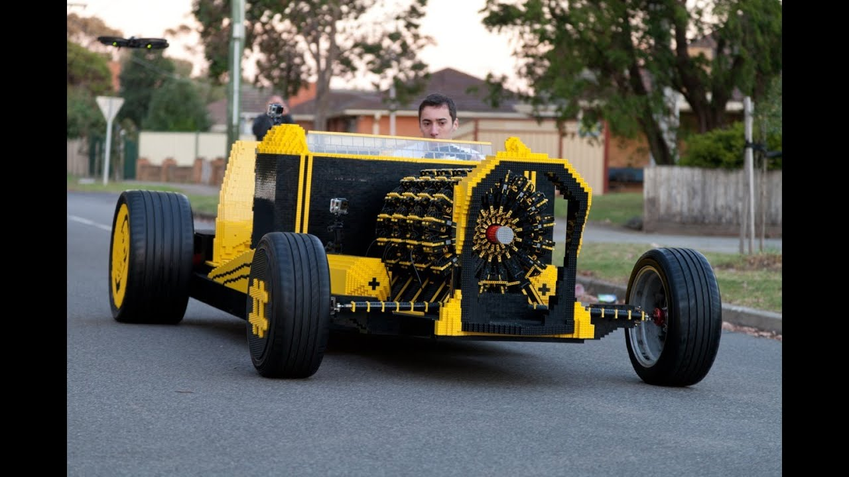
Actual Working Lego Car - https://www.youtube.com/watch?v=qHQZcRPqUkY

