Slide 1
Is there a relationship between a pitcher’s Earned Run Average (ERA) and the number of strikeouts?
Sample Presentation – Mr. Linden

Slide 2
Population
Population includes all major league pitchers from the 2018 baseball regular season. Pitchers needed to pitch at least 50 innings to be included in the list.
The population includes both starting pitchers and relievers.
My sample consisted of 30 pitchers.

Slide 3
Description of Data
Independent Variable is a pitcher’s Earned Run Average (ERA). Earned run average is calculated by dividing the number of earned runs allowed by the number of innings pitched and multiplying by nine.
  This is a Numerical – Continuous statistic.
Dependent Variable is a pitchers number of Strikeouts.
  This is a Numerical – Discrete statistic.

Slide 4
Sampling Technique
I used a Simple Random Sample technique to collect my data.
I went to MLB.com and selected Stats. I made sure to use the 2018 regular season. I selected pitchers only and selected pitching statistics. I sorted the statistics based on IP and organized the list from greatest to least.
I used a random number generator to create a sequence of 30 numbers.
I used those numbers to record each players name, team, ERA, and strikeouts.

Slide 5
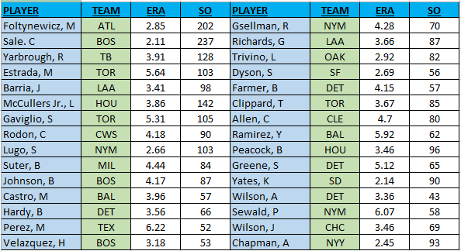
Data Table Collected May, 16, 2019

Slide 6
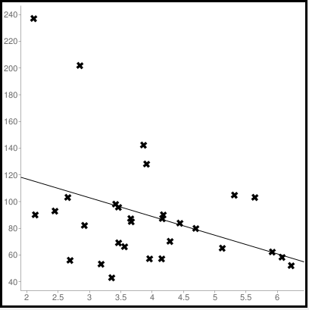
Scatterplot

Slide 7
Pearson’s Correlation Coefficient R
The correlation coefficient for the data: R = -0.376
This indicates that there is a moderately weak, relationship between a player’s ERA and number of strikeouts.
The relationship is negative, which makes sense, for the study. The lower the pitcher’s ERA is the more strike outs he has thrown.

Slide 8


Line of Fit & Coefficient of Determination
The Line of Best Fit:
The y-intercept relates to the number of strikeouts
Coefficient of Determination
This indicates that only 14% of the variation in the data can be explained by the line of fit.
This would not be a good model to predict future behaviors.

Slide 9
Descriptive Statistics
 | Earned Run Average (ERA) | Strikeouts
Mean | 3.917 | 90
St. Deviation | 1.11197 | 41.40129
Confidence Interval | 3.519 < mu < 4.315 | 75.185 < mu < 104.815

Slide 10
Conclusion
In conclusion there does not seem to be a very good relationship between a pitcher’s ERA and the number of strike outs.
On average a pitcher has an approximately 3.91 ERA with around 90 strikeouts.

